Slide 1
Take some candy

Slide 2
In your groups
Share what a perfect summer day looks and feels like for you.
What are your favorite outdoor spaces?

Slide 3

What we did last week?
Brainstorm over the meanings of each of these terms:
Youth
Participatory
Action
Communication
Research

Slide 4
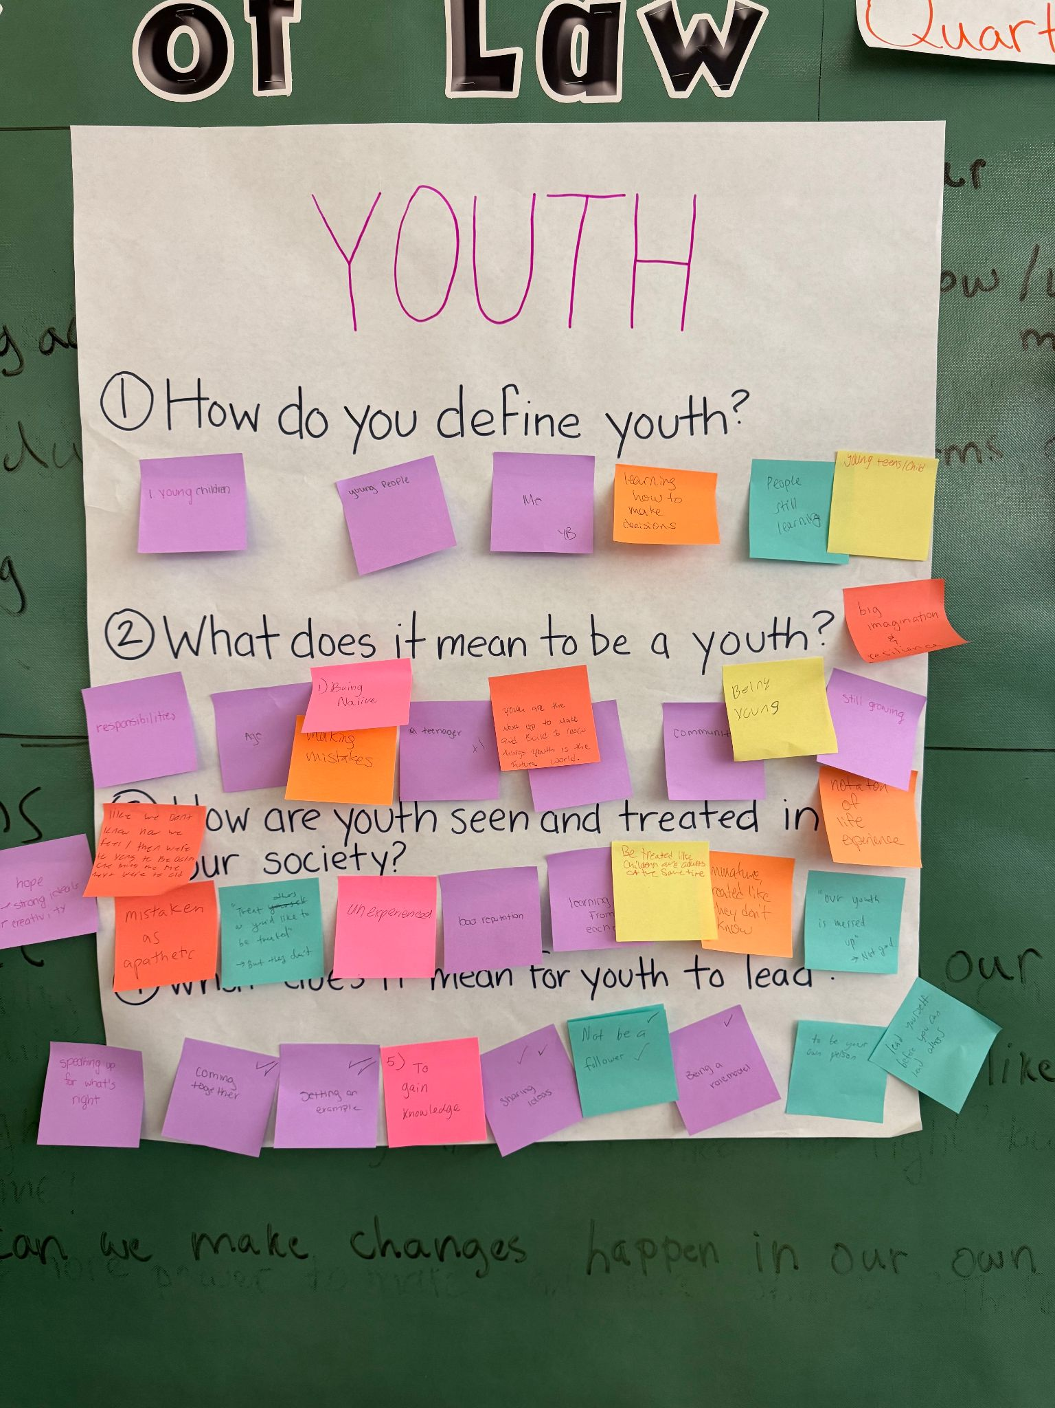
Q1. How do you define youth?
Young children
Young people
Me
Learning how to make decisions
People who are still learning
Young teens/child
Q3. How are youth seen and treated in our society?
Like we don’t know how we feel/
Mistaken as apathetic
Hope and strong ideals, and creativity
“Treat others as you’ll like to be treated” but they don’t
Unexperienced
Bad reputation
Learning from each other
Be treated like children and adults at the same time
Immature, treated like they don’t know
“Our youth is messed up” not good
Q2. What does it mean to be a youth?
Responsibilities
Age
Being naive
Making mistakes
Teenager (+)
Youth are the next up to make and build and learn things
Youth is the future of the world
Community
Being young
Still young
Still growing
Not a ton of life experience
Big imagination & resilience
Q4. What does it mean for youth to lead?
Speaking up for what’s right (++)
Coming together
Setting an example (++)
To gain knowledge
Sharing ideas (++)
Not be a follower (++)
Being a role model (+)
To be your own person
Lead yourself before you can lead others

Slide 5
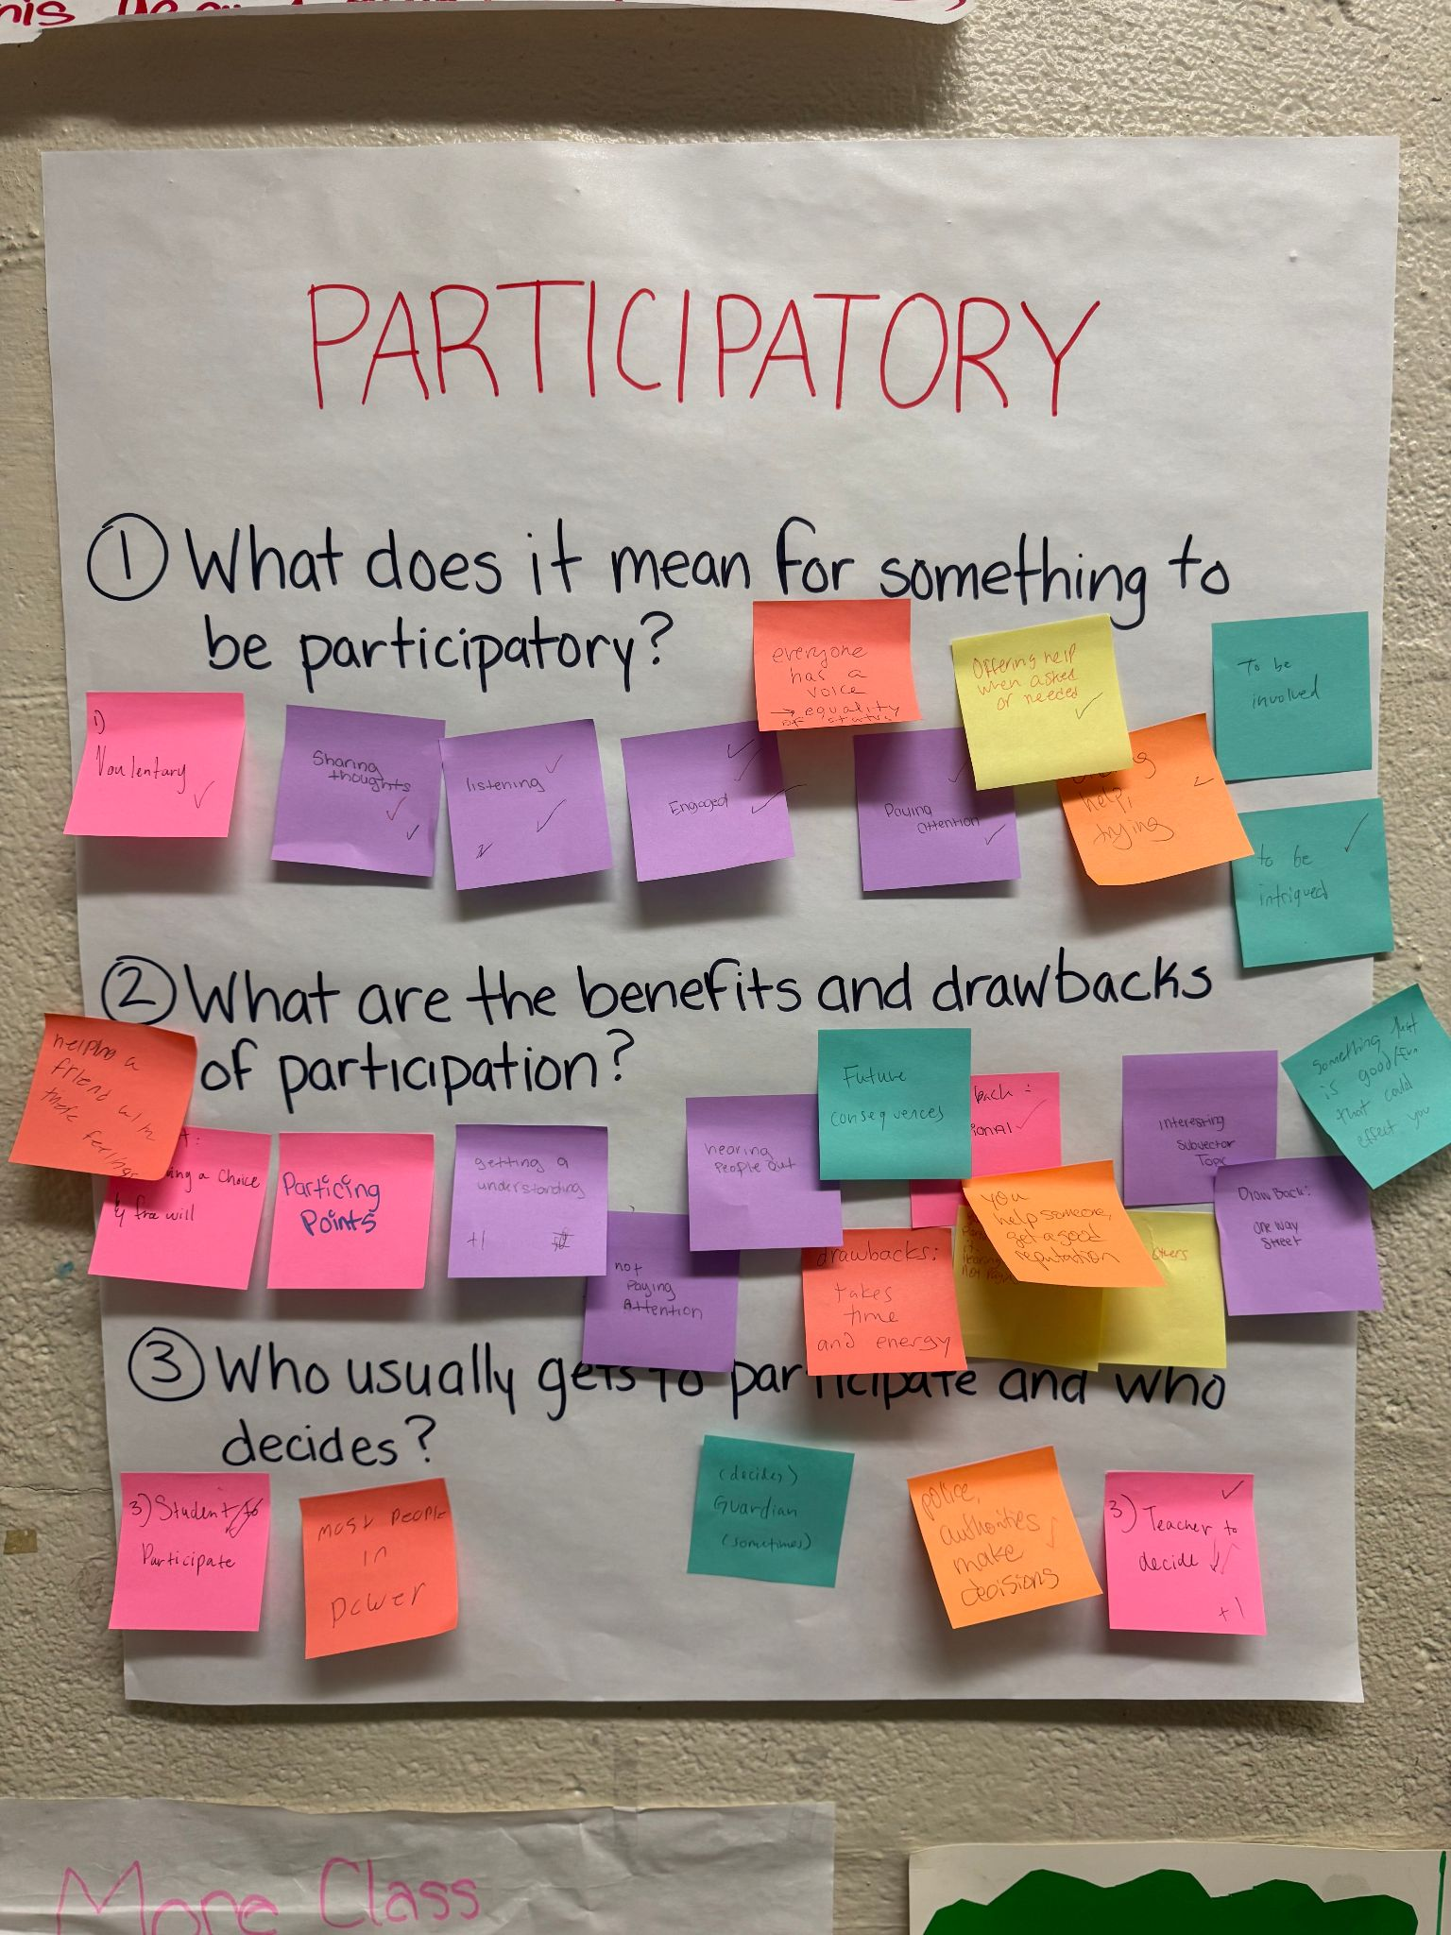
Q1. What does it mean to be participatory?
Voluntary (+)
Sharing thoughts (++)
Listening (+++)
Engaged (+++)
Everyone has a voice, equality of status
Paying attention (++)
Offering help when asked or needed (+)
Offering help or trying (+)
To be involved
To be intrigued (+)
Q2. What are benefits and drawbacks of participation?
Benefits:
Helping a friend with their feelings
Having a choice, free will
Practicing points
Getting an understanding (+)
You help someone and get a good reputation
Hearing people out (+)
Interesting subject or topic
Something that is good or fun that will affect you
Drawbacks:
Not paying attention (+)
Future consequences
Takes time and energy
Emotional (+)
Not giving others a chance to participate and overdoing it
One way street
Q3. Who usually gets to participate and decide?
Student to participate (++)
Most people in power
Decide - Guardian (sometimes)
Police, authorities make decisions (+)
Teacher to decide (++++)

Slide 6
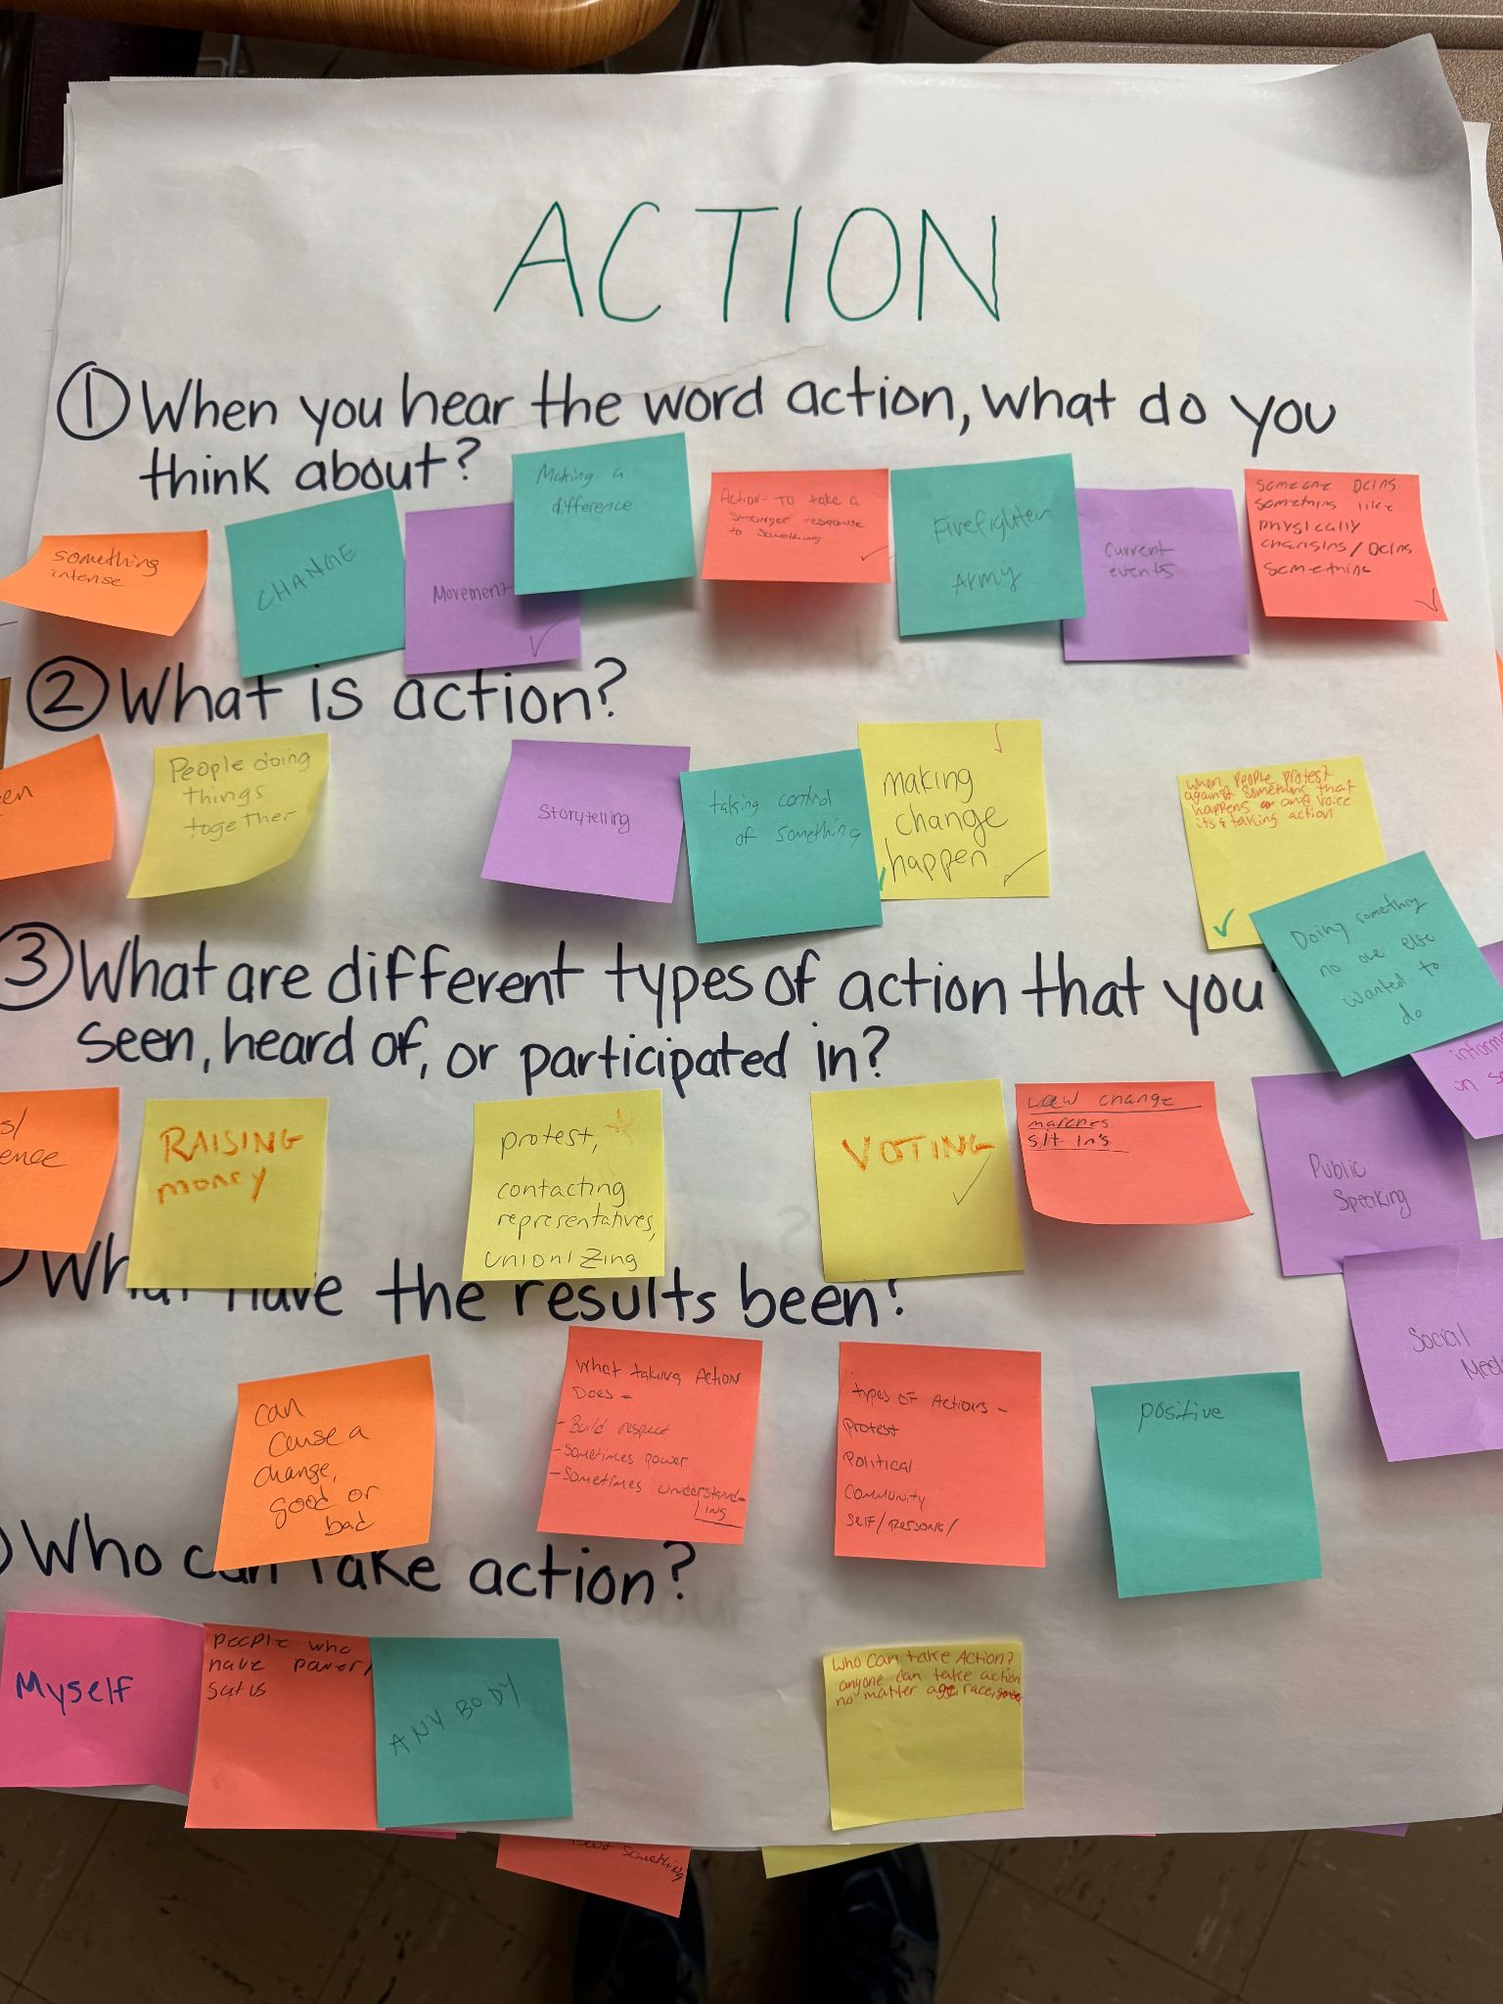
Q1. When you hear the word action what do you think about?
Something intense
Change
Movement (+)
Making a difference
Action - to take a stronger response to something (+)
Firefighter and army
Current events
Someone being something like physically changing/ doing something
Q3. What are different types of action you seen, heard, or participated in?
Riots/ violence
Raising money
Protest (+)
Political
Community
Self/personal
Contacting representatives
Unionizing
Voting (+)
Law change
Marches
Sit ins
Public speaking
Social media
Sharing information in social media
Q2. What is action?
Sudden act
People doing things together
Storytelling
Taking control of something
Making change happen (+++)
When people protest against something that happens and voice it’s taking action
Doing something no one else wanted to do
Q4. What were the results?
Can cause a change, good or bad
What taking action does - build respect, sometimes power, sometimes understanding
Positive
Q5. Who can take action?
Myself
People who have power/ SCOTUS
Anybody
Anyone who can take action, no matter age, race, gender
Notes:
Using what we find out in our research to make change happen.

Slide 7
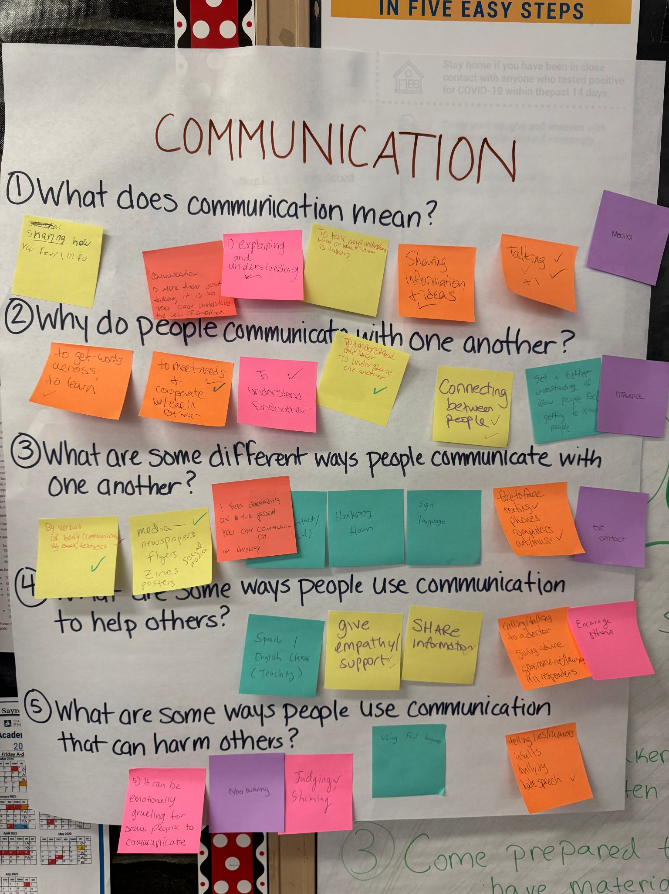
Q1. What does communication mean?
Sharing how you feel/ information
Communication is more than just talking it is so you can understand the view of another
Explaining and understanding (+)
To talk and understand what or whom is talking
Sharing information of ideas (+)
Talking (++++)
Media
Q3. What are different ways people communicate?
By verbal or body communication, by email, text, etc. (++)
Media, newspapers, flyers, Zines, posters, Social media (+)
I feel depending on the person you can communicate in any way
Eyes, eye contact/nonverbal (+)
Honking horn
Sign language
Face to face, texting, phones, computers, art, music (++)
Q2. Why do people communicate?
To get words across, to learn (+)
To meet needs and cooperate with each other (+)
To understand each other/one another (+++)
Connecting between people (+)
Get a better understanding of how people feel/ getting to know people
Influence
Q4. What are some ways people use communication to help others?
Speech/ English classes (teaching)
Give empathy/support (++)
Share information (+)
Calling/talking to a doctor
Giving advice
Government/lawyers
All responders
Encourage others
Q5. What are some ways people use communication to harm others?
It can be emotionally gruelling for some people to communicate
Cyber bullying
Judging, shaming (+)
Using foul language
Telling lies, rumors, insults, bullying, hate speech (+)

Slide 8
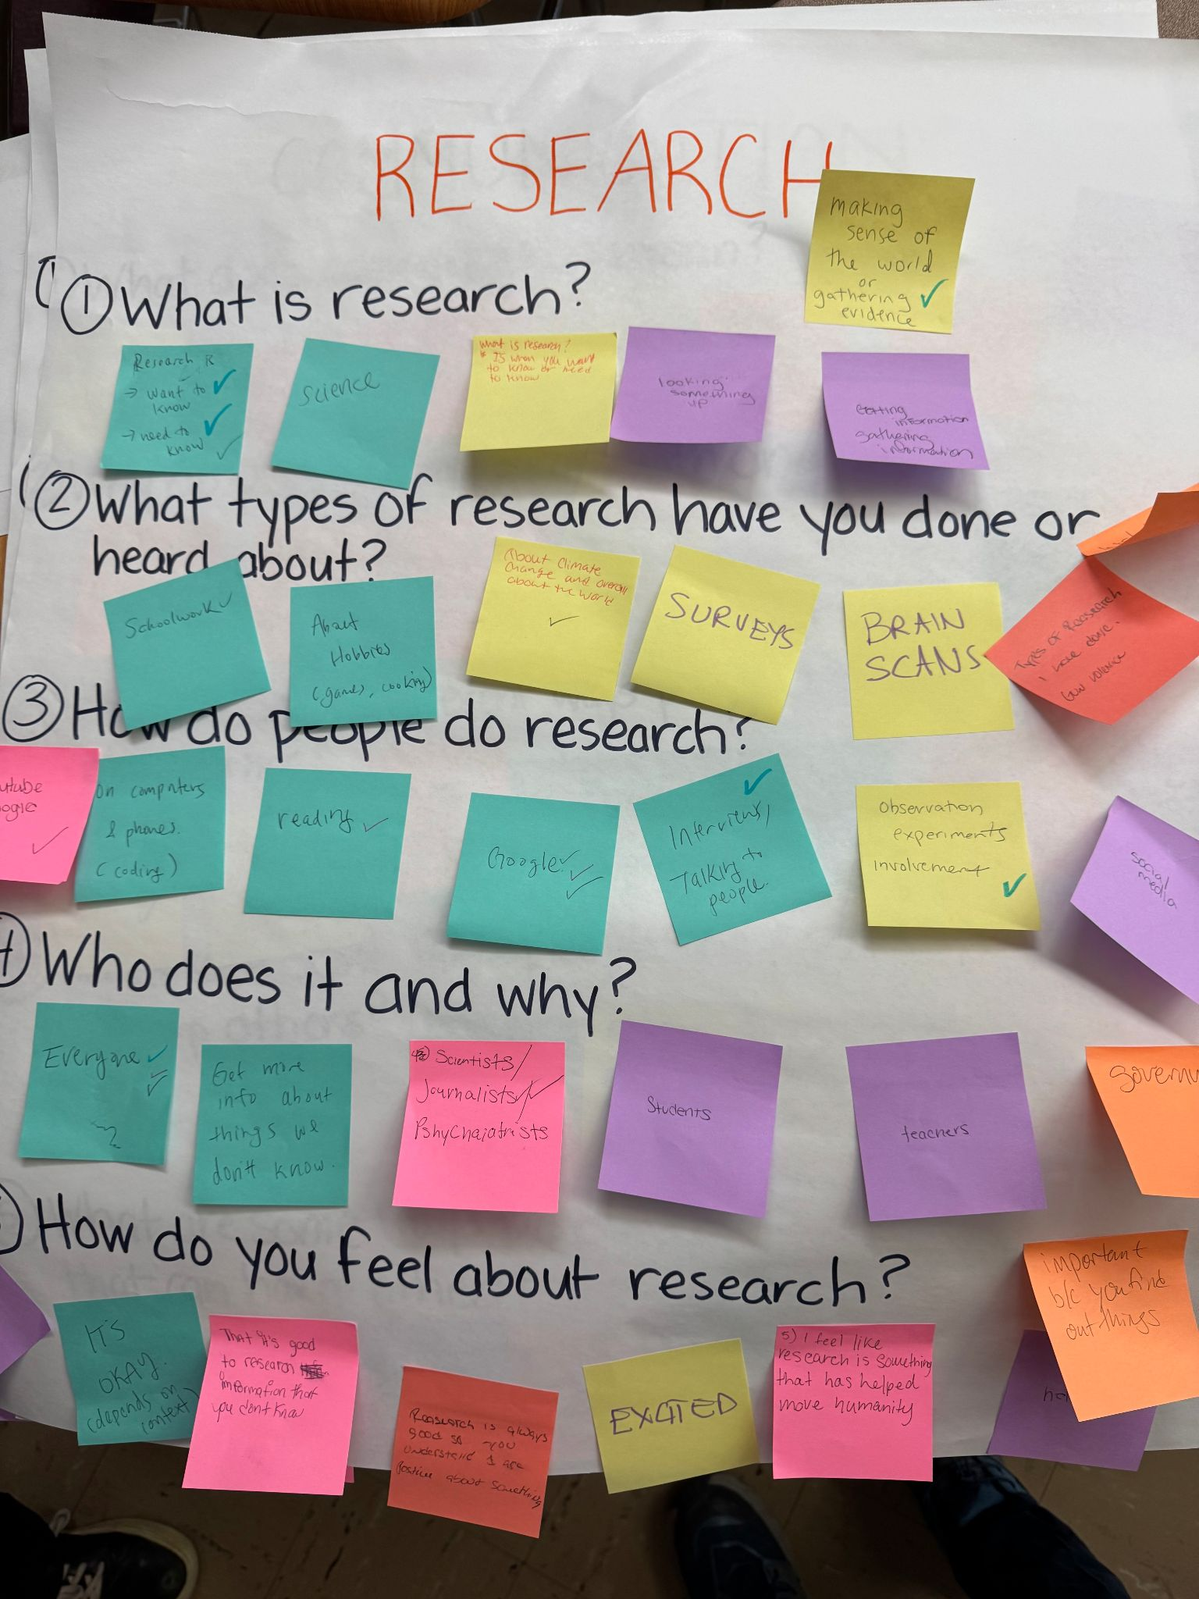
Q1. What is research?
Research is Want to know and Need to know (++++)
Science
Looking something up
Making sense of the world or gathering evidence (+)
Getting information, gathering information
Q4. Who does research and why?
Everyone (+++)
Get more info about things we don’t know
Scientists, journalists (++), psychiatrists
Students’
Teachers
Government
Q2. What types of research have you done or heard about?
Schoolwork (+)
About hobbies (games, cooking)
About climate change and overall about the world (+)
Surveys
Brain scans
Gun violence
Historical research using the internet
Q5. How do you feel about research?
Interested
It’s okay, depends on the context
That it’s good to research information that you don’t know
Research is always good so you understand and are positive about something
Excited
I feel like research is something that has helped move humanity
Important because you find out things
Helpful (+)
Q3. How do people do research?
YouTube, Google (+)
On computers and phones (coding)
Reading (+)
Google (+++)
Interviews/talking to people (+)
Observation, experiments, involvement (+)
Social media

Slide 9
Key ideas - Youth, Participatory, Action, Communication, and Research
Y: Young people in a stage in life where they are developing their sense of self
P: Coming together to share ideas and make decisions through collaborative activities
A: Doing something and finding solutions to create positive change, make a difference in our community and society
C: Sharing information and cooperating to reach understanding
R: Investigation into a question or problem that involves gathering information, making meaning, and sharing findings

Slide 10
Definition of YPACR
A method of investigating a problem, gathering information, and implementing a solution that involves the knowledge of young leaders in a process of sharing ideas and information, learning, and growth—in collaboration with researchers and community members—with attention to sharing knowledge/information and reach community understanding
Notes:
Notes
growing and learning together
emphasize that the goal is to empower in response to the negative responses about youth in the activity
most potential misalignment around “participatory”; distinction between who makes decisions and who participates
highlight empowerment that they’re making decisions as part of the participatory process
communication: what role does this play? → use broad definition, name the idea that we can systematically study communication / how information flows
define communication and research instead of using them
reword to remove jargon/make language accessible
proposal: include 2 slides—one summarizing each word, one joining them into a collective definition
a method of investigating a problem and implementing a solution that involves the knowledge and leadership of adolescents in a process of sharing ideas and information, learning, and growth--in collaboration with researchers and community members-- with attention to theories involved in communication studies

Slide 11
Climate Brainstorm
Brainstorm as a group what are some impacts of heat and green space on the community you have experienced
You have 5 minutes at each of the stations to dot vote or add new ideas
At the end of all 3 stations, summarize your group’s ideas for the following questions
When it’s hot out, how does that impact how you feel, and what you can do – at home, school, and other places in our community? Are some people you know more impacted than others?
Are there places you have used to cool down, where are they?
How does having trees, parks and other green spaces impact how you feel, and what you can do in our community? Does having access to green space affect the temperature that you feel?

Slide 12
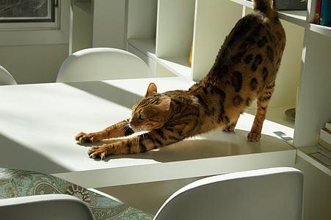
Stretch Break

Slide 13
Choosing your group for today
Group 1: Addressing gun violence
Group 2: Promoting mental health & wellbeing
Group 3: Meeting social and resource needs
Mental health
Substance use
LGBTQ rights
Women's health
Homelessness
Community clean up
Food security
Poverty
Police brutality
Notes:
Group 1 -

Slide 14
In your group:
Share what is your favorite green space. What do you all have in common?
Why did you choose this topic?
What do you already know about this topic from your research in the fall?
What do you want to know more about?
Is there a connection that comes to mind when you think of this topic and heat or green space?

Slide 15
How are heat or green space related to your group’s topic?
Here’s some of what scientists know about the connection between your group’s topic and heat/green space
[Have one member read statements aloud for your group’s topic]
How do you feel about reading this? Does it match/differ from your experience? How does this affect you?
Brainstorm ways that your topic might be affected by heat and green space using your group flipchart & sticky notes.

Slide 16
 | Heat impacts on your topic | Green space impacts on your topic
Positive impacts
Negative impacts

Slide 17
Team Circle
What is one thing you learned today?
What is one thing you’re curious to know more about next time we meet?

